Slide 1
Smart Agent Recruitment Challenge
Presented By: Rohan Giri

Slide 2

Introduction
Our client, FinMan is a Financial Distribution company. Over the last 10 years, they have created an offline distribution channel across India.
The company sells Financial products to consumers by hiring agents in their network and makes a significant investment for identifying, training and recruiting these agents.
As, there are a set of agents who do not bring in the expected resultant business. So, the objective is to analyze and observe the overall past recruitment data to help your client derive meaningful insights.

Slide 3
Features In Given Data
Categorical
ID
Office PIN
Application Receipt Date
Applicant City PIN
Applicant Gender
Applicant Martial Status
Applicant Occupation
Applicant Qualification
Manager Joining Designation
Manager Current Designation
Manager Grade
Manager Status
Manager Gender
Date
Applicant Birth-Date
Manager DOJ
Manager DOB
Numerical
Manager Num Application
Manager Num Coded
Manager Business
Manager Num Products
Manager Business2
Manager Num Products2
Business Sourced (Target)

Slide 4
Range Of Numerical Features
FEATURE | MIN VALUE | MAX VALUE
APPLICANT AGE | 15 | 77
MANAGER AGE | 19 | 56
MANAGER NUM APPLICATION | 0 | 22
MANAGER NUM CODED | 0 | 9
MANAGER BUSINESS | -265289 | 3578265
MANAGER NUM PRODUCTS | 0 | 101
MANAGER BUSINESS 2 | -265289 | 3578265
MANAGER NUM PRODUCTS 2 | 0 | 101

Slide 5
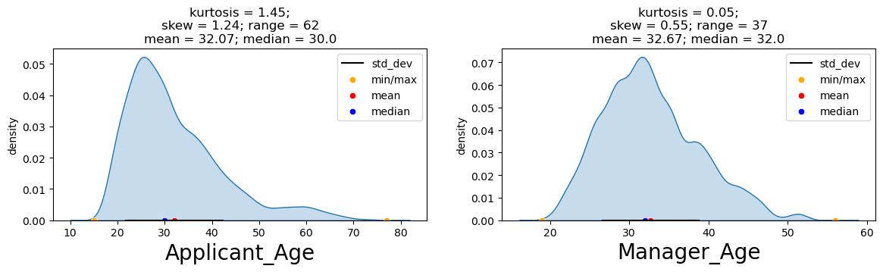
Numerical Features

Slide 6
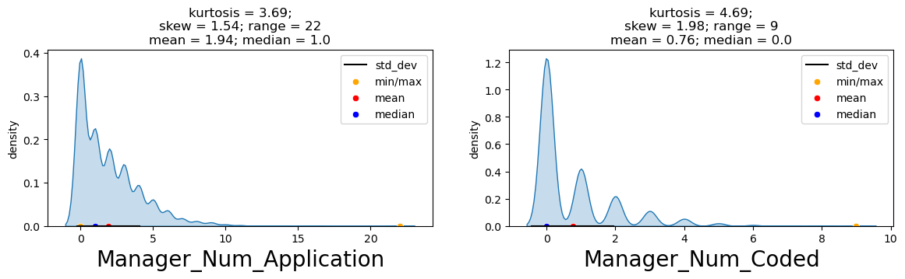
Numerical Features

Slide 7
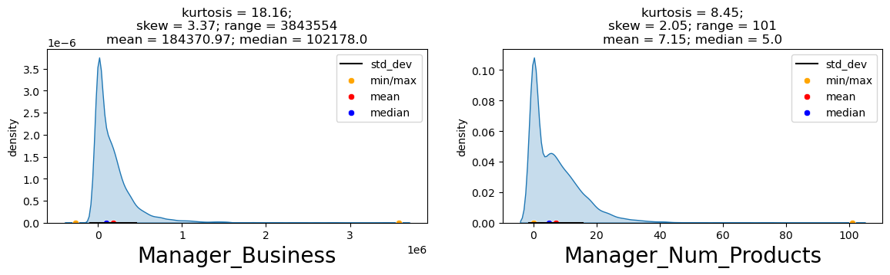

Numerical Features

Slide 8
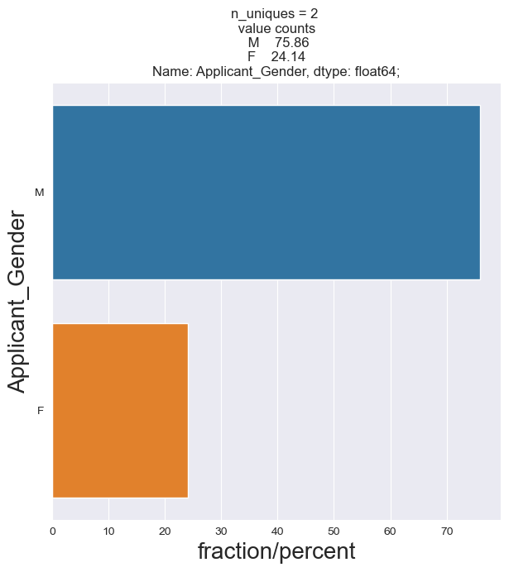
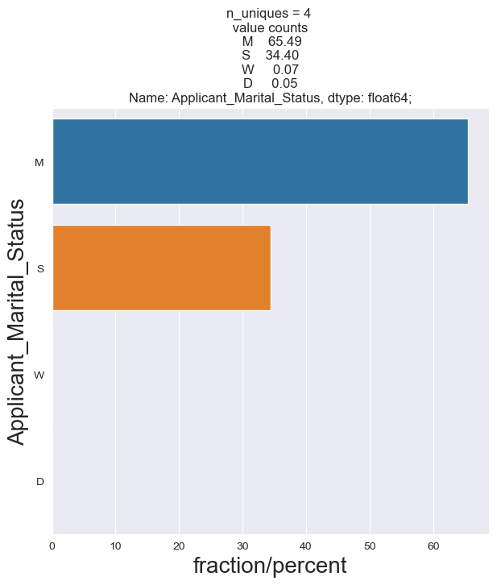
Categorical Features

Slide 9
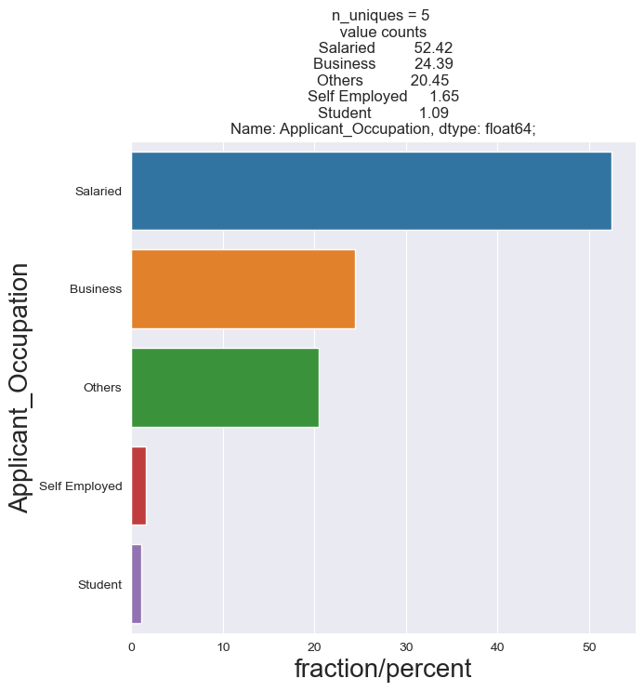
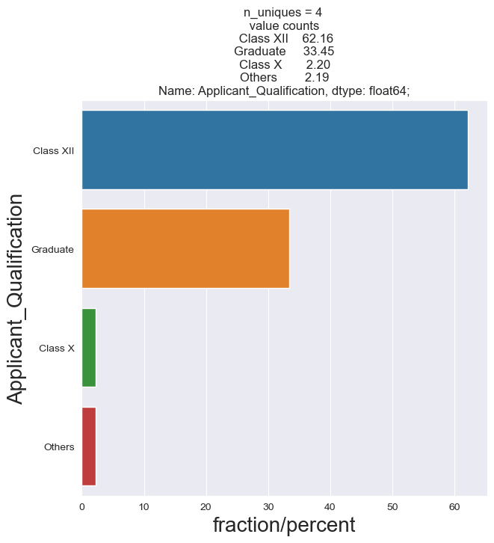
Categorical Features

Slide 10
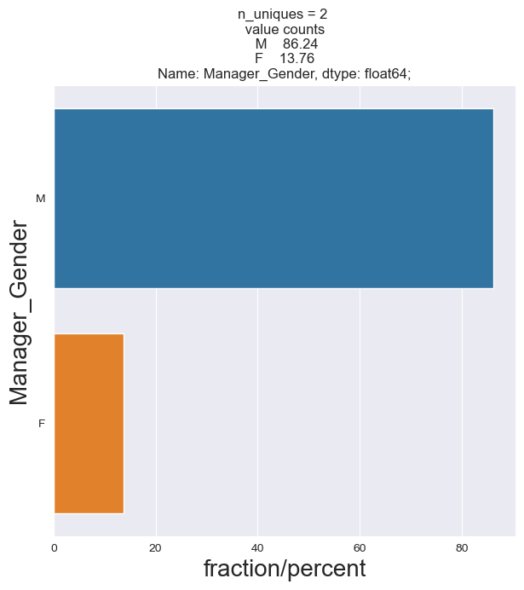
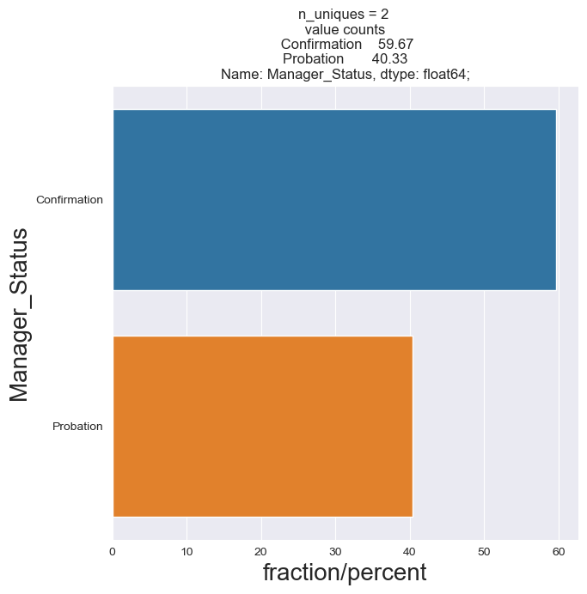
Categorical Features

Slide 11
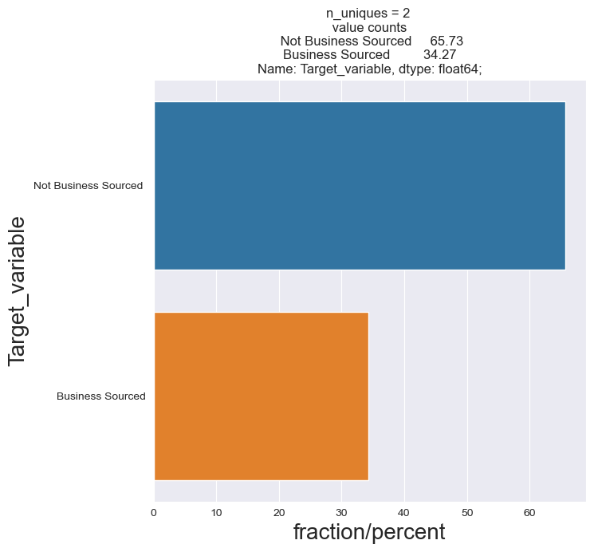
Categorical Features

Slide 12
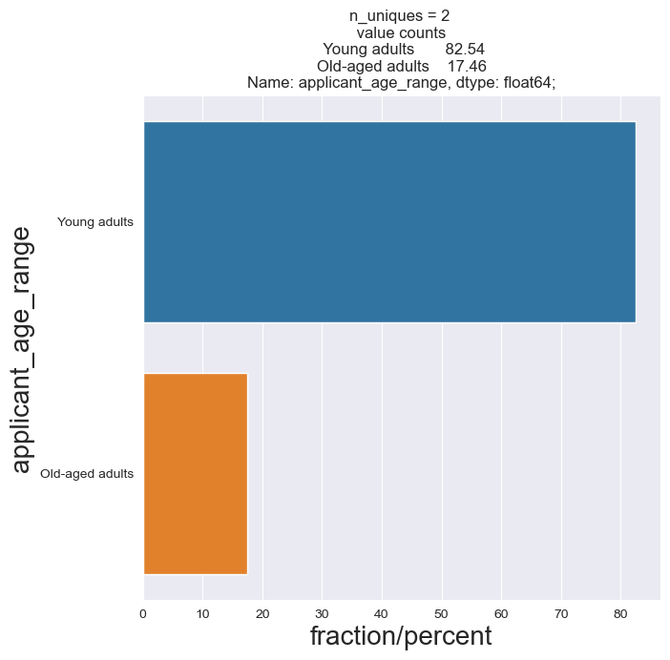
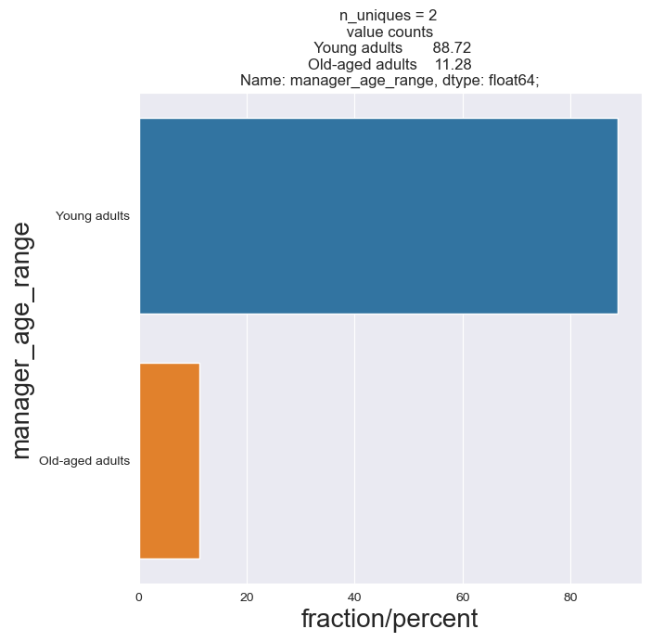
Categorical Features

Slide 13
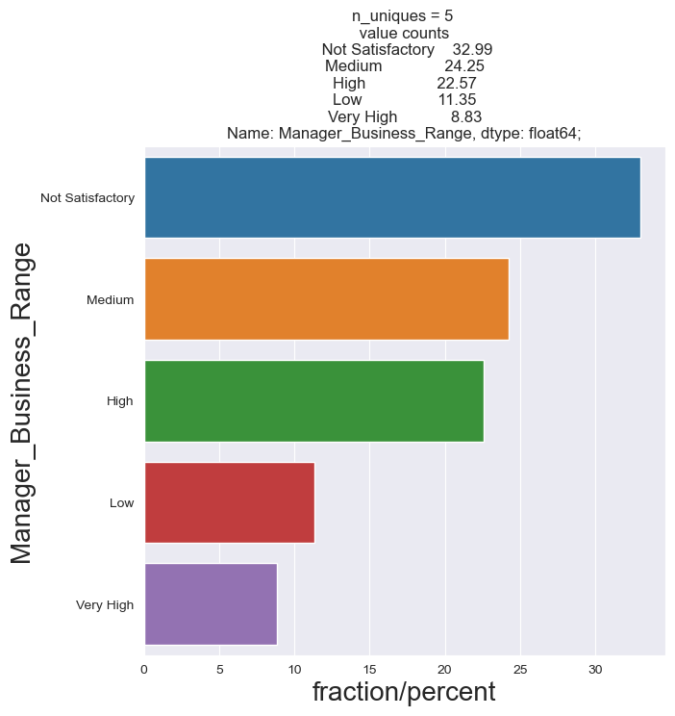
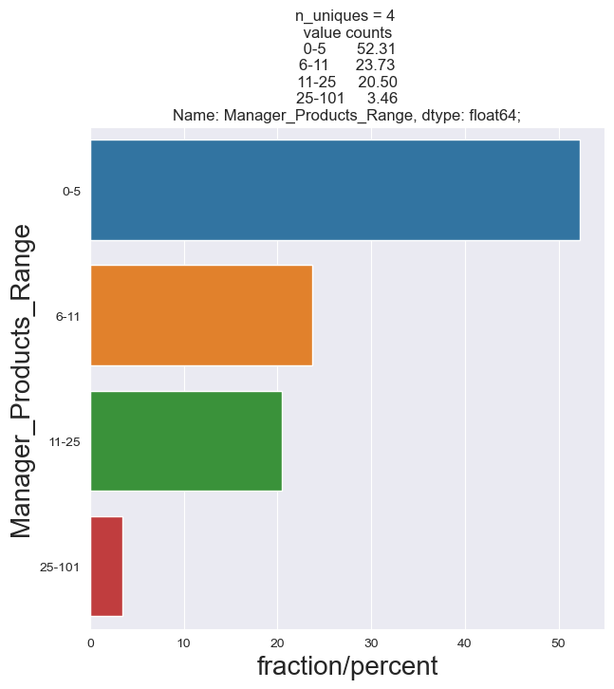
Categorical Features

Slide 14


Categorical Features

Slide 15
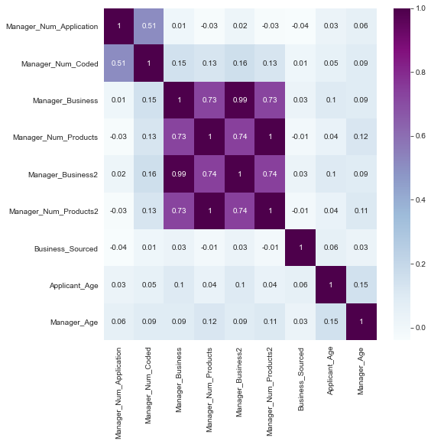
Correlation

Slide 16
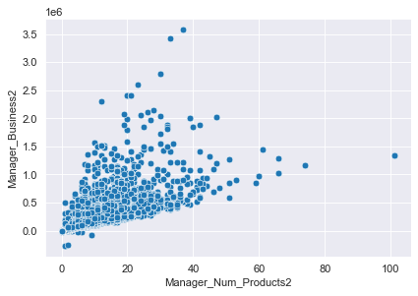
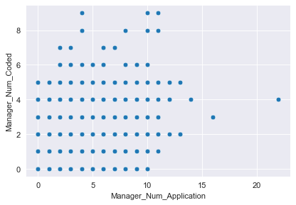

Slide 17
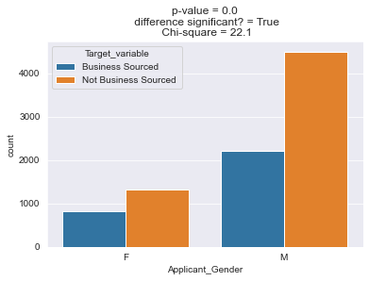
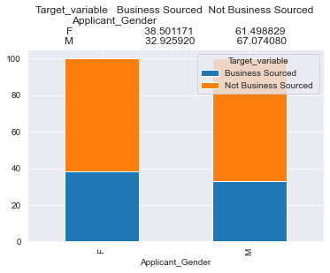
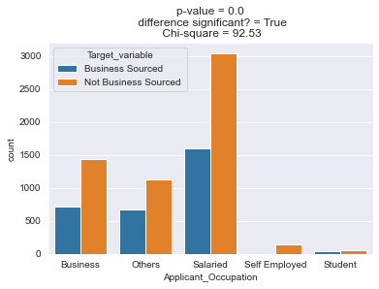
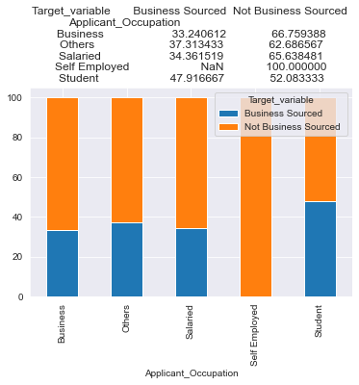
Analysis

Slide 18
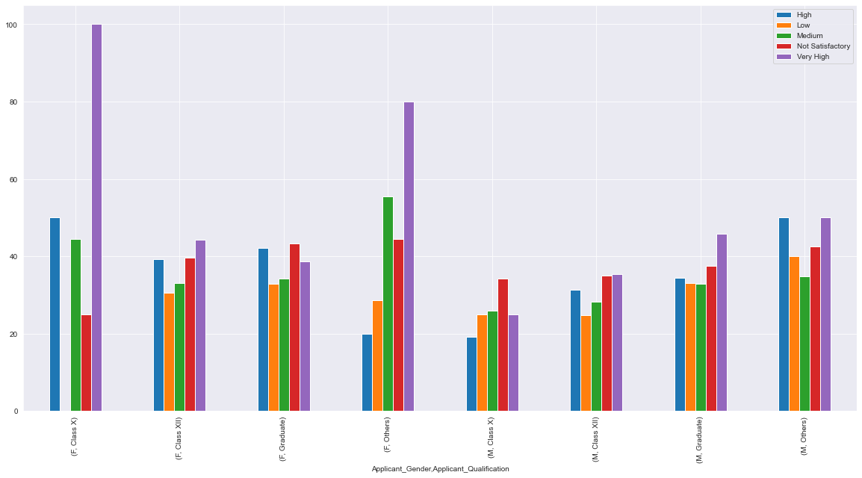
Analysis

Slide 19
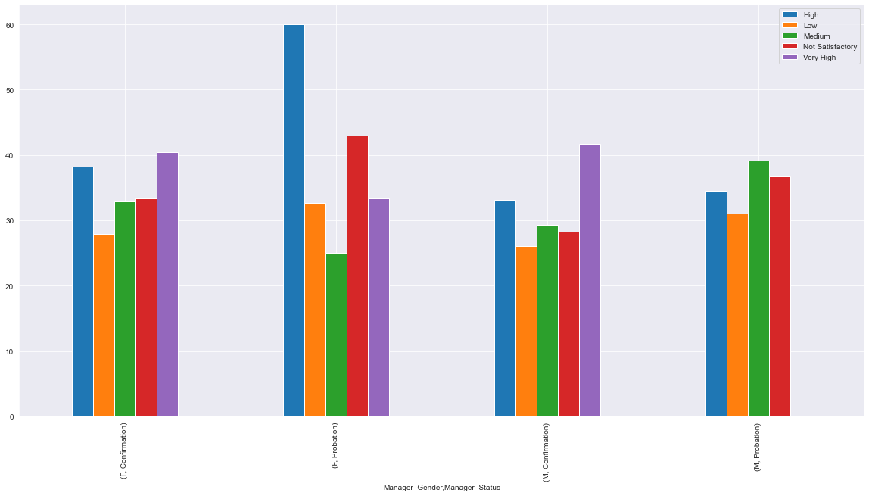
Analysis

Slide 20

Conclusion
Needs improvement in reducing negative amount of business source.
Business sourced by female applicants are more than business sourced by males on average.
Females managers with the status of confirmation is doing better than other managers comparatively.

Slide 21

Recommendations
Self employed applicant needs to be improved or should not be recruited for becoming agents.
Strength of female agents should be increased.
Females managers should recruit more applicants.

Slide 22
THANK YOU

Slide 23
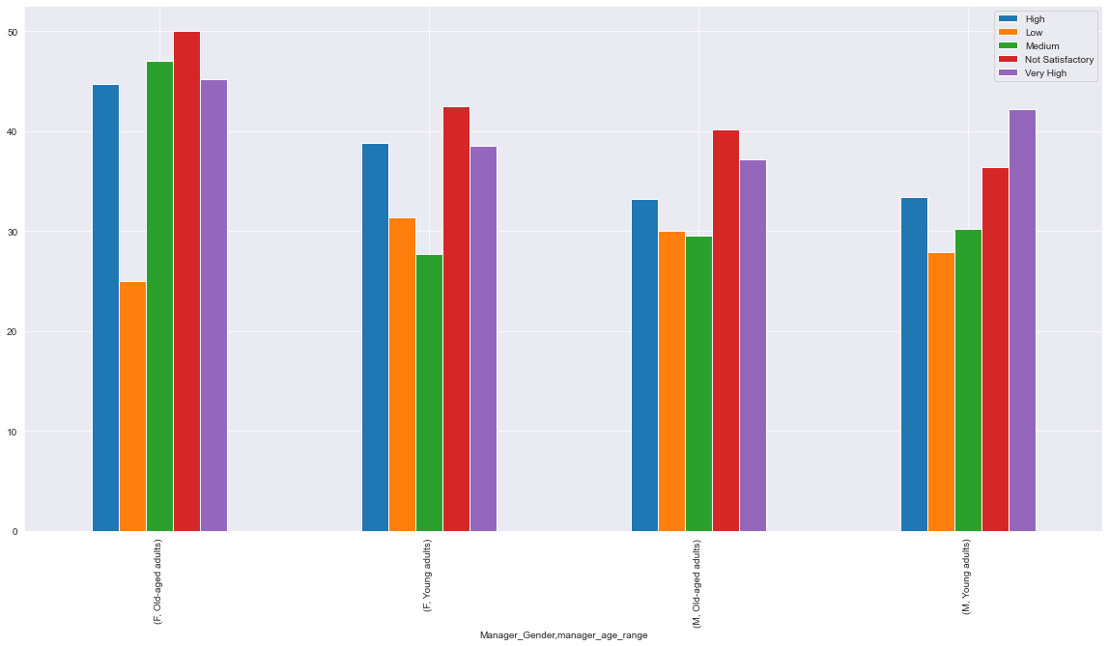
Analysis

